Slide 1


Scope and importance of floriculture in India

Slide 2

INTRODUCTION
Flowers are associated with the mankind from the dawn of Civilization.
It is said that man is born with flowers, lives with flowers and finally dies with flowers .
Flowers are used for various purposes in our day to day life like worshipping, religious and social functions, wedding, interior decoration veni , perfume industry, dye extraction and self adornment.

Slide 3
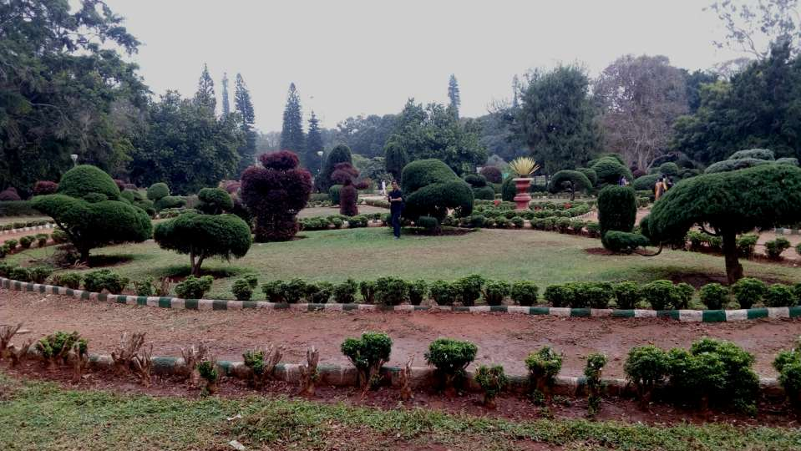

FLORICULTIRE
Floriculture is the aesthetic branch of horticulture which deals not only with cultivation of ornamentals, annuals, biennials and perinnial plants including potted ones but also their marketing . This also include marketing for local ,distant marketsand export of cut flowers, live plants and their economic products like scents, oils and medicines etc.

Slide 4
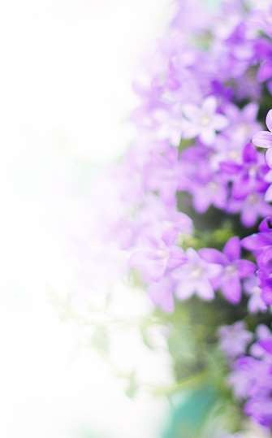
Different flowers are used to convey the human feelings
Rose for love
Pancy for thoughts
Carnation white for women‘s love
French Marigold for jealousy/ sorrow
African Marigold for vulgar minds
Narcissus for self esteem

Slide 5

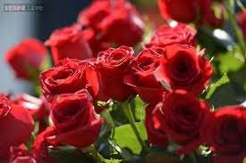
LOVE

Slide 6

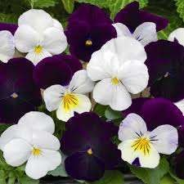
THOUGHTS

Slide 7

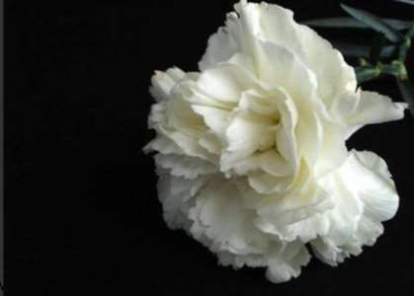
WOMEN’S LOVE

Slide 8

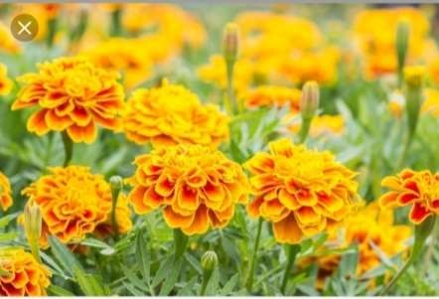
JEALOUSY/SORROW

Slide 9

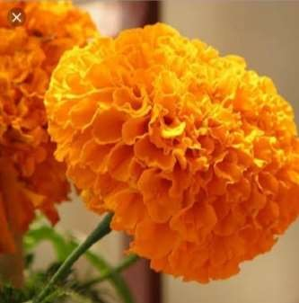
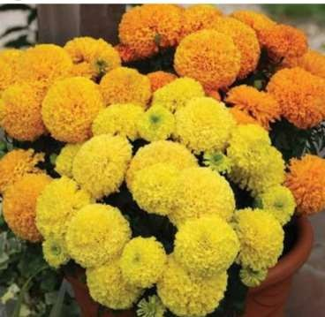
VULGAR MINDS

Slide 10

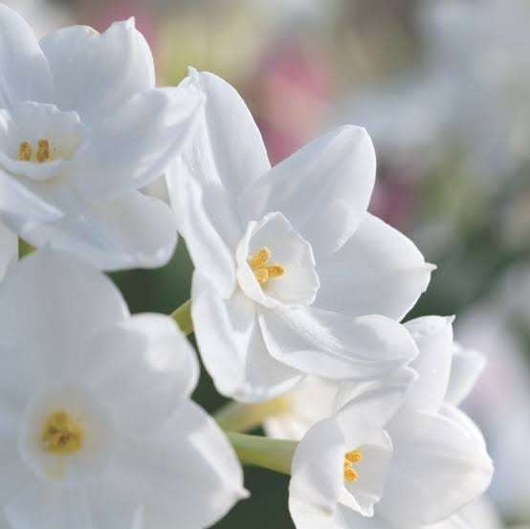
SELF ESTEEM

Slide 11
Daffodil for regard
Amaryllis for pride
Iris for message
Snapdragon for presumption
jasmin for amiability
Lily for purity
stock for luxury
sweet pea for departure

Slide 12

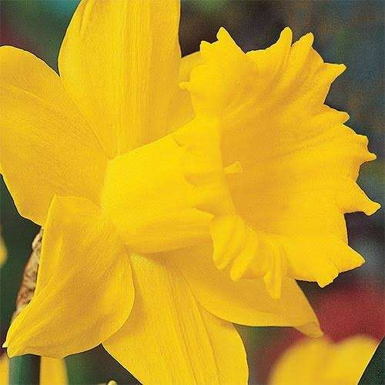
REGARD

Slide 13

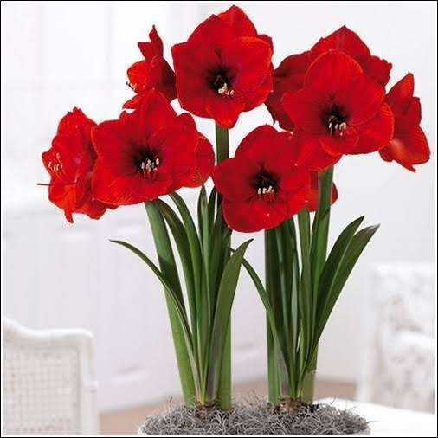
PRIDE

Slide 14

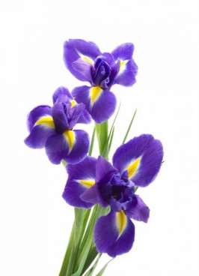
MESSAGE

Slide 15

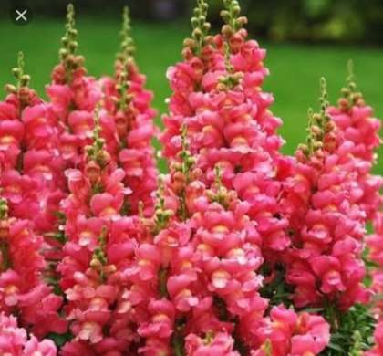
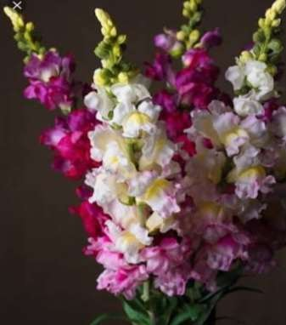
PRESUMPTION

Slide 16
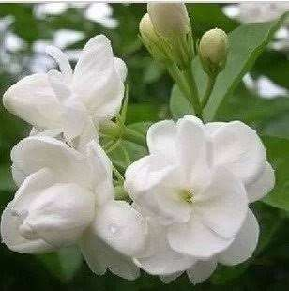

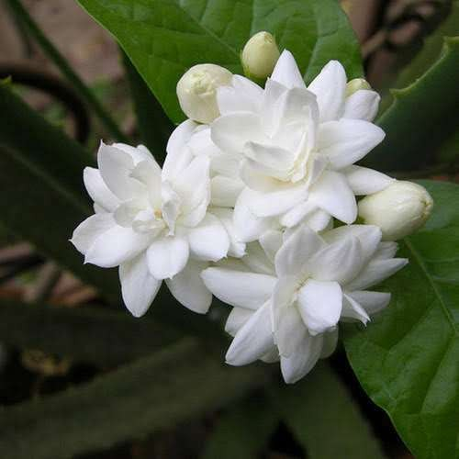
AMIABILITY

Slide 17

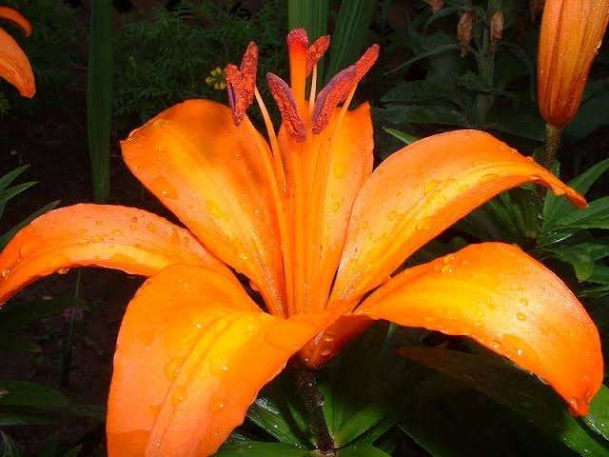
PURITY

Slide 18

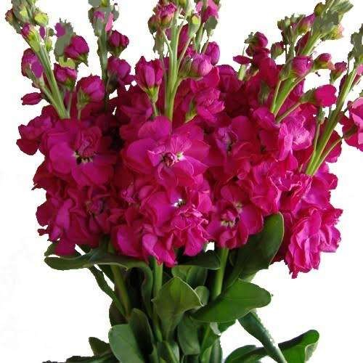
LUXURY

Slide 19
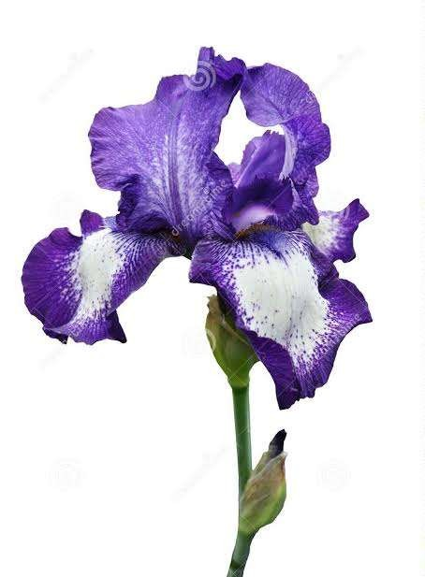

DEPARTURE

Slide 20



Scope and importance
Rising demand of cut flowers and live plants due to urbanisation .
India and other Asian countries have been emerging as development centres of floriculture
Favourable soil and climate
Several government schemes NHB,APEDA, NABARD

Slide 21

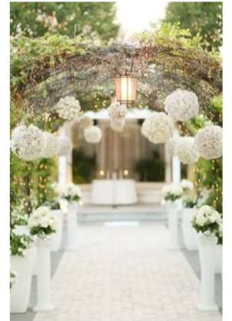
Flowers used for festivals weddings, pooja funerals, function, wall decorations, carpet bedding, foreign exchange (cultural and traditional importance )

Slide 22
Source of income for small and marginal farmers
Self employment venture
Improvement of waste land
Indoor and outdoor landscaping

Slide 23
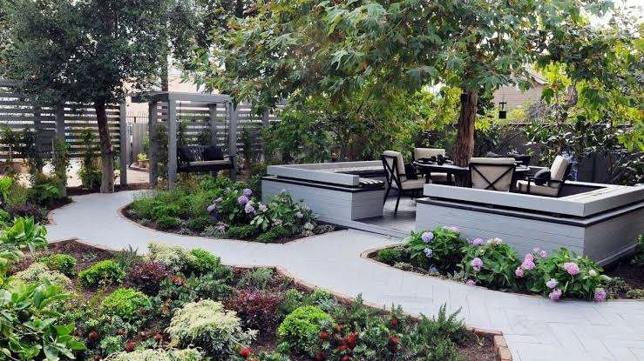

Slide 24
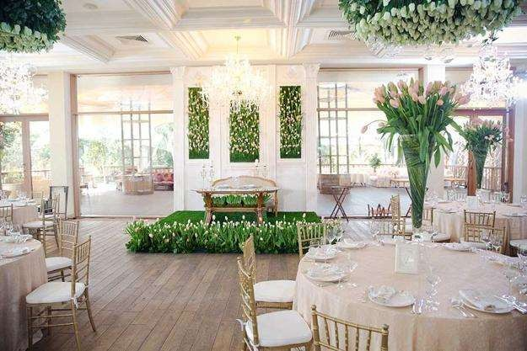

Slide 25
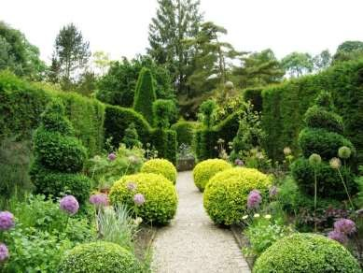
Need to realise the importance of ornamental plants in parks ,garden which gives aesthetic beauty, refreshed minds.

Slide 26
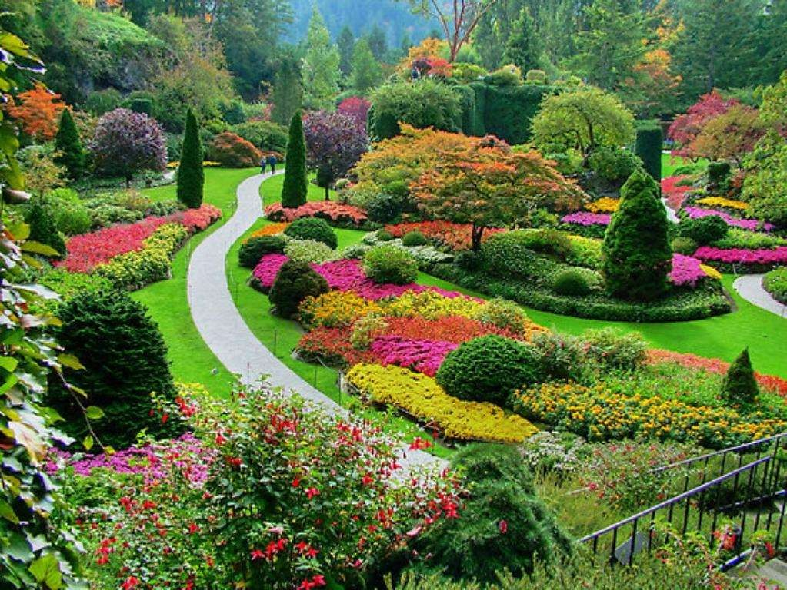

Slide 27

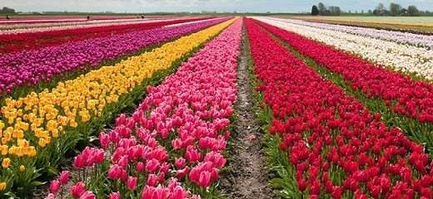
Used as hedge plants, border plants , foundation.
Export of value added products

Slide 28

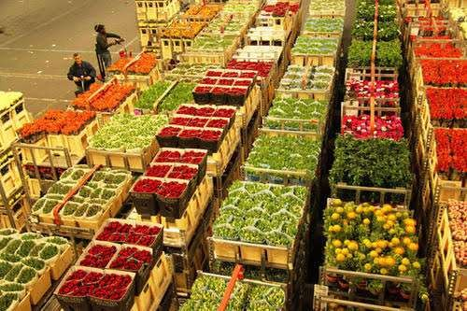
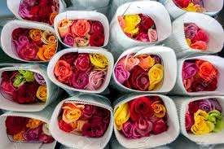

Slide 29
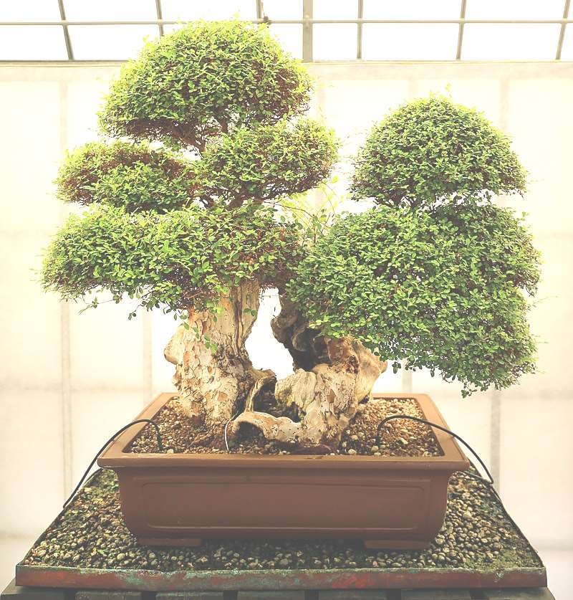
Bonsai development

Slide 30
Employment in processing industries
Demand in export of cut flowers has increased
Prevents rural as well as urban air pollution
India being diverse have many ornamental crops thus there is a scope of the domestication of beautiful wild crops

Slide 31


Role of ornamental crops in pollution control
Plants maintain the ecological balance
Enhances the beauty of the place
Source of food, shelter , medicine and also timber
Maintain soil moisture , minimise soil erosion
Prevent surface evaporation

Slide 32
Serves as a good mulching material
Green area is maintained to control the environment change, reduces light intensity
Control atmospheric pollution increases atmospheric humidity
Flowering ornamentals promotes apiculture
Increases rainfall

Slide 33



Present status in world
Major flower producing country -Netherlands
Country with largest acreage of flora crops under greenhouse- Netherlands
Major cut flower producing country- Netherland
Major cut flower importing country -Germany

Slide 34



Present status in India
Besides beauty and aesthetic values of flowers they are important for their economic value as sale of flowers( loose as well as cut blooms), extraction of essential oils and making of economic products like gulkand.
The present position of floriculture in India is not as bright and lucrative as it is in European countries and the USA

Slide 35
Compound annual growth rate of 26%
Share in global floricultural sector- 0.61%
Largest area under flowers -West Bengal
Largest producer of loose flowers -Tamilnadu
Largest producer of Cut flowers -Karnataka

Slide 36

Strengths
Climate
The varied climate of India makes it most suitable for growing flowers in one part or the other so that flowers can be produced the year round
Soil
The soil of different climatic zones is very favourable for growing different types of flowers.

Slide 37
Abundant rainfall North West and Southwest monsoon
Variety of flowers
Low labour cost

Slide 38

Weakness
Inadequate storage facility
Less value addition
Highly perishable in nature
Existing facility of airlines cannot meet at the time of peak demand
Lack of cold storage chains.(refrigerated vans)

Slide 39

Opportunities
Green house cultivation has more demand
Potential supplier during lean season
Subsidy for storage- APEDA
Government incentives NABARD
Reduction in import duties on cut flowers
Increasing demand in world market
Self employment
High potential - value addition

Slide 40
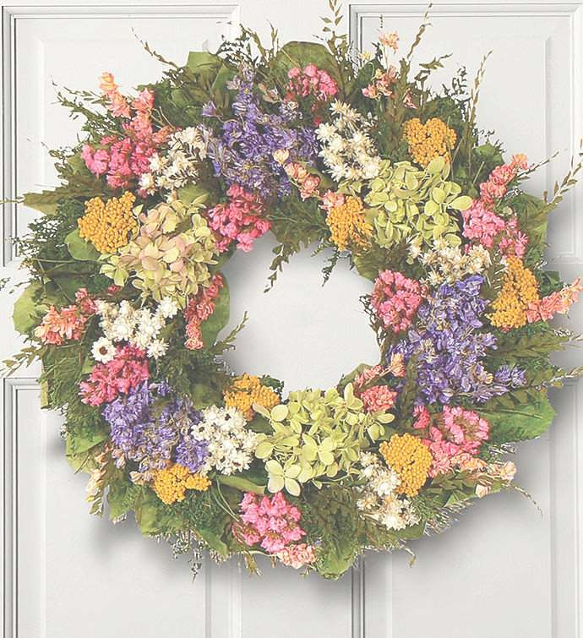



Value addition
Flower
Bouquets, garlands,wreaths,scents
Dry flower
Bouquets, wreaths, garlands, interior decorations, cards, pot pourri

Slide 41
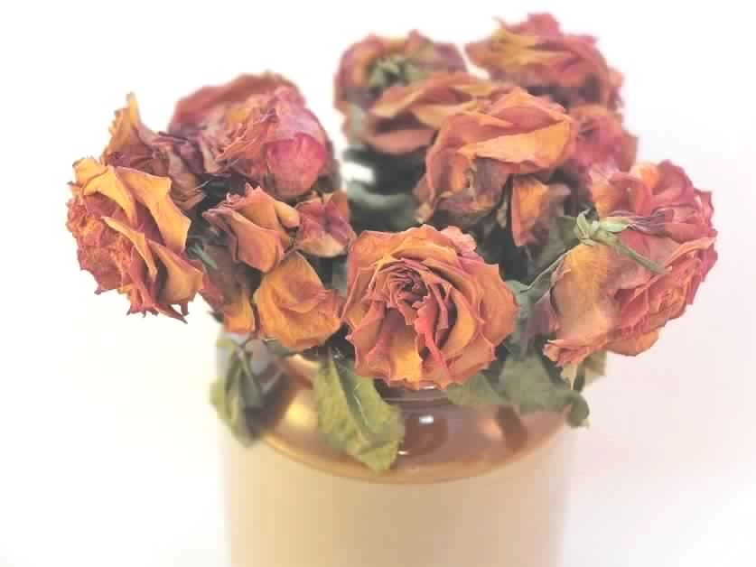
Medicine
vincristine and vinblastine
Dyes
Essential Oils
Dried foliage

Slide 42
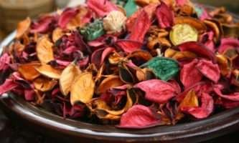
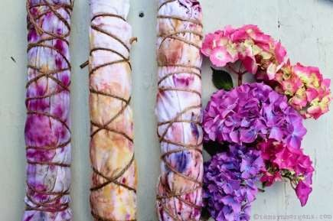

Slide 43
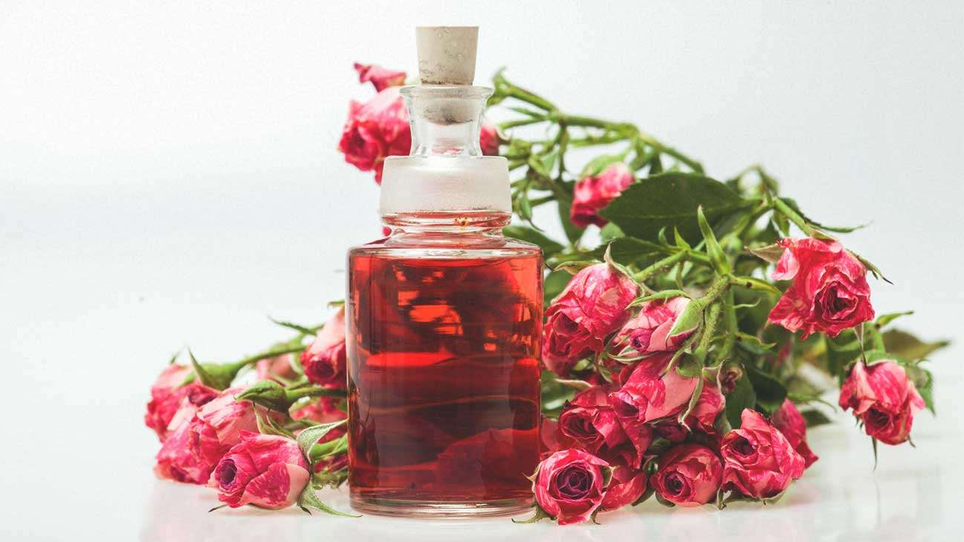
• essential oils

Slide 44
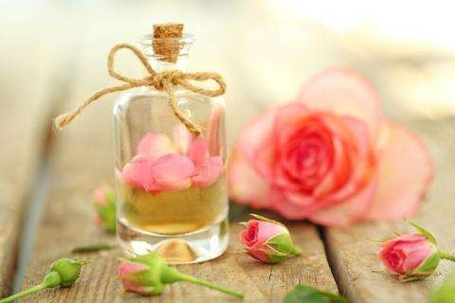
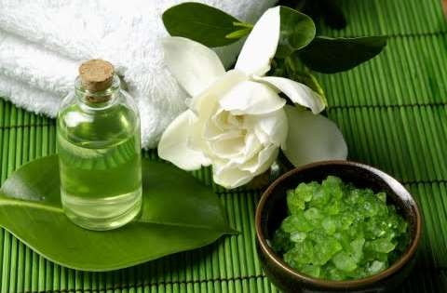

Slide 45


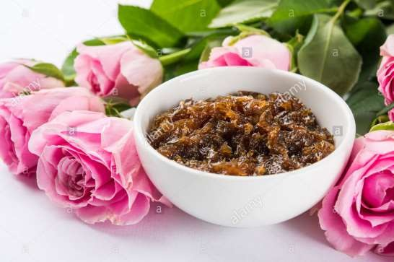
Economic products
Gulkand of rose

Slide 46
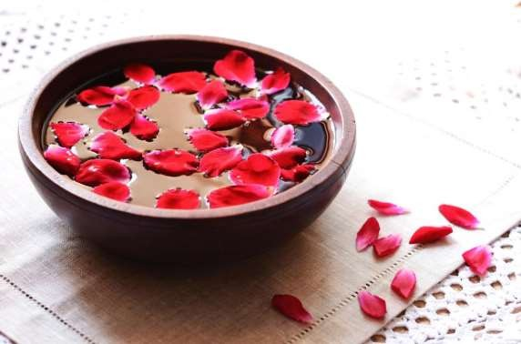
rose water

Slide 47
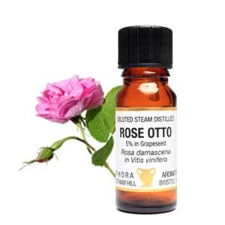
rose otto

Slide 48
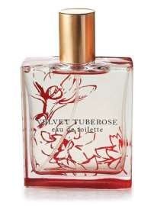
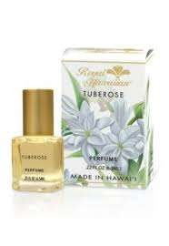
Perfumes of flowers like tube rose , pandanus, molsari, Juhi ,Chameli

Slide 49

Bonsai development
Bonsai are mini plant which have great importance in morden landscaping of homes , restaurants , hotels etc.
plants like bougainvillea, rubber tree, quamquats , pomegranate , Ficus benghalensis
, Ficus infectoria , Ficus religiosa ,Pinus longifolia etc. Can be used for making bonsai and local as well as in foreign markets.

Slide 50
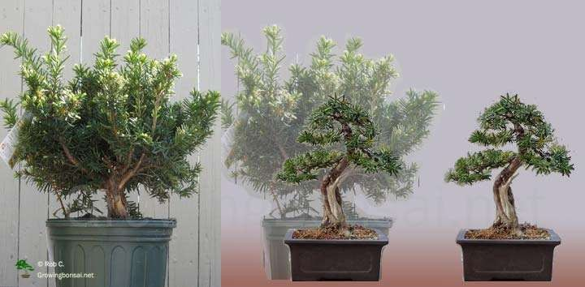

Slide 51

Challenges
Emerging flower growing regions- Africa and other Asian countries
Pest and disease attack
Climate vagaries
High capital investment
Higher fuel and energy charges

Slide 52

REFERENCE
Introductory Ornamental Horticulture
-J.S.Arora

